Slide 1

A Project Report On
APPLICATIONS OF MACHINE LEARNING ALGORITHMS IN AGRICULTURE
Presented By
INTURU CHANDANA [220200046116]
Under The Guidance Of
Mr. N. VENKATA KRISHNA, M.Tech.,
Associate Professor
Department of Computer Applications
KRISHNA CHAITANYA INSTITUTE OF SCIENCE AND TECHNOLOGY
KAKUTURU- NELLORE (2022 – 2024)

Slide 2
Abstract
Machine learning (ML) makes machines independent and self-learning component. Researchers applying machine learning algorithms to solve various real word problems in various domains. Nowadays agriculture affects by various factors such as global warming, climatic changes, lack of manpower, etc.
To help the farmers from the above factors and increase agriculture production, recently many machine learning techniques are utilized in the agricultural filed. In this paper, we studied different applications of machine learning techniques in the agriculture domain.
We classified applications of machine learning algorithms in agriculture by four categories namely, machine learning in plant monitoring, machine learning in soil analysis, machine learning in detection (or) prediction process in agriculture, machine learning in animal monitoring.

Slide 3
Introduction
Nowadays, precision agriculture aims at increasing productivity and maximizing the yields of a crop. The entire crop cycle can benefit from an application of the correct amount of spray (such as water, fertilizers, pesticides or fungicides) at the proper time and place. In parallel, research on multispectral image analysis of agricultural fields is starting to detect diseases in plants. Farmers generate maps of spatial variabilities based on geo-located sensors.
The sensors collect many variables and provide historical and real time information. Recently, Unmanned Aerial Vehicles (UAV) have enabled precision agriculture. These drones are equipped with multispectral or RGB cameras to collect aerial images and create maps of the selected region. High precision agriculture applies mainly to yield monitoring or remote sensing. It is only started to be applied to vineyards on complex landscapes and difficult topographies.

Slide 4
Existing System
The methodology utilizes Principal Components analysis (PCA) not withstanding Support Vector Machines (SVMs) and Linear Discriminate Analysis (LDA) algorithms for feature extraction and arrangement.
We demonstrated that machine Learning algorithms dependent on morpho-colorimetric parameters and NIR examination independently were capable to classify leaves of 16 grapevine cultivars. Automated picture analysis for morphological and color highlights extraction of checked leaves combined with ANN displaying rendered fast, exact and modest techniques to be utilized for ampelo graphy/ cultivar characterization.

Slide 5
Disadvantages Of Existing System
PCA not supporting to calculate accuracy for SVM and LDA algorithm the main problem is PCA does not supporting more than 10 components from the given dataset.
Existing model does not support to classify leaves of 16 and also model id not trained to predict and detect disease in leaves and plants so that ANN algorithm failed to resolve problem in Agriculture Field.

Slide 6
Proposed System
The farmers rely on the traditional ways of farming which is based on the reliability of the suggestions from the elderly and their experience.
This method leaves farmers at the mercy of random climatic conditions which are already getting random due to global warming and uneven rainfall patterns. The manual spraying method for pesticides led to improper usage of resources and harms the environment.

Slide 7
Advantages Of Proposed System
To resolve the problem in agriculture such as lack of water, excess rain, soil pollution due to plastics, synthetic fertilizer we applied selected dataset with decision tree, Random forest, Support vector Machine Learning.
It is imperative to monitor the pH value, temperature and concentration changes in nutrient solution composition as the performance of soilless cultivation is highly dependent on these parameters. The significant variables in a nutrient solution cannot be measured directly hence these are determined with the help of auxiliary variables.

Slide 8
Software Requirements
SYSTEM SPECIFICATIONS:
Operating system : Windows 10 Ultimate.
Coding Language : Python.
Front-End : Python.
Designing : Html, css, javascript.
Data Base : MySQL

Slide 9
Hardware Requirements
System : Pentium IV 2.4 GHz.
Hard Disk : 500 GB.
Monitor : 14’ Colour Monitor.
Mouse : Optical Mouse.
Ram : 8 GB.

Slide 10
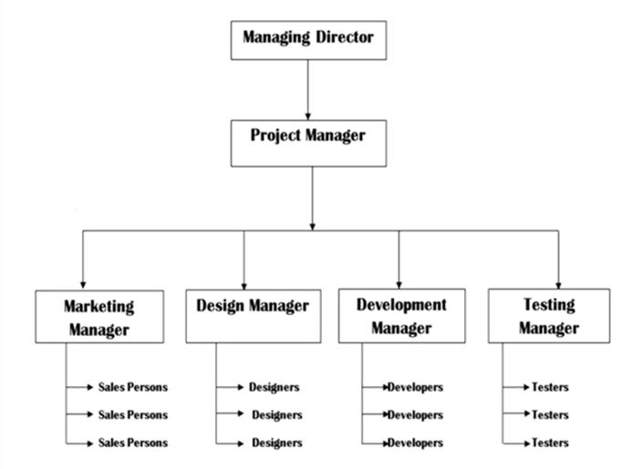
Organization Chart:

Slide 11
MODULES
Data Collection
Data collection is a very basic module and the initial step towards the project. It generally deals with the collection of the right dataset. The dataset that is to be used in the market prediction has to be used to be filtered based on various aspects. Data collection also complements to enhance the dataset by adding more data that are external. Our data mainly consists of the previous year stock prices. Initially, we will be analyzing the Kaggle dataset and according to the accuracy, we will be using the model with the data to analyze the predictions accurately.

Slide 12
Pre-Processing Data
pre-processing is a part of data mining, which involves transforming raw data into a more coherent format. Raw data is usually, inconsistent or incomplete and usually contains many errors. The data pre-processing involves checking out for missing values, looking for categorical values, splitting the data-set into training and test set and finally do a feature scaling to limit the range of variables so that they can be compared on common environs.

Slide 13
Training the Machine
The machine is similar to feeding the data to the algorithm to touch up the test data. The training sets are used to tune and fit the models. The test sets are untouched, as a model should not be judged based on unseen data. The training of the model includes cross-validation where we get a well-grounded approximate performance of the model using the training data. Tuning models are meant to specifically tune the hyperparameters like the number of trees in a random forest. We perform the entire cross-validation loop on each set of hyperparameter values. Finally, we will calculate a cross-validated score, for individual sets of hyperparameters. Then, we select the best hyperparameters. The idea behind the training of the model is that we some initial values with the dataset and then optimize the parameters which we want to in the model. This is kept on repetition until we get the optimal values. Thus, we take the predictions from the trained model on the inputs from the test dataset. Hence, it is divided in the ratio of 80:20 where 80% is for the training set and the rest 20% for a testing set of the data.

Slide 14
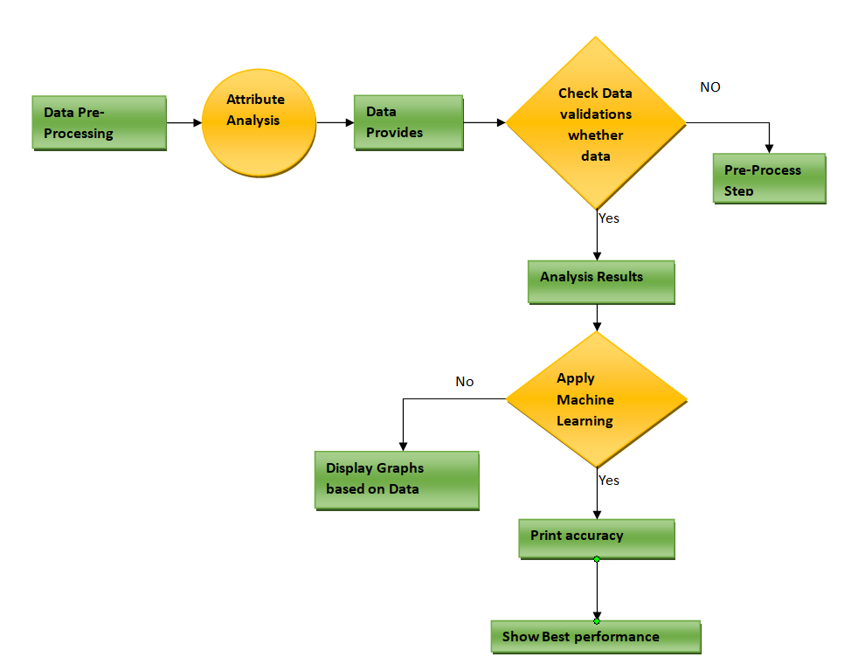
System Design
Data Flow Diagram

Slide 15
Use Case Diagram

Slide 16
Class Diagram

Slide 17
Sequence Diagram

Slide 18
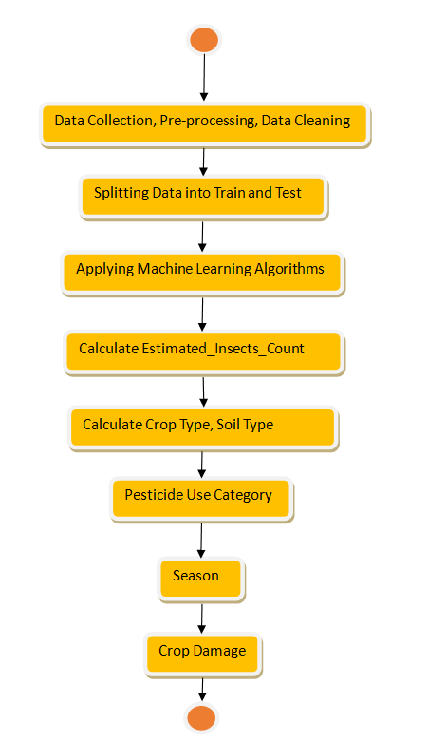
Activity Diagram

Slide 19
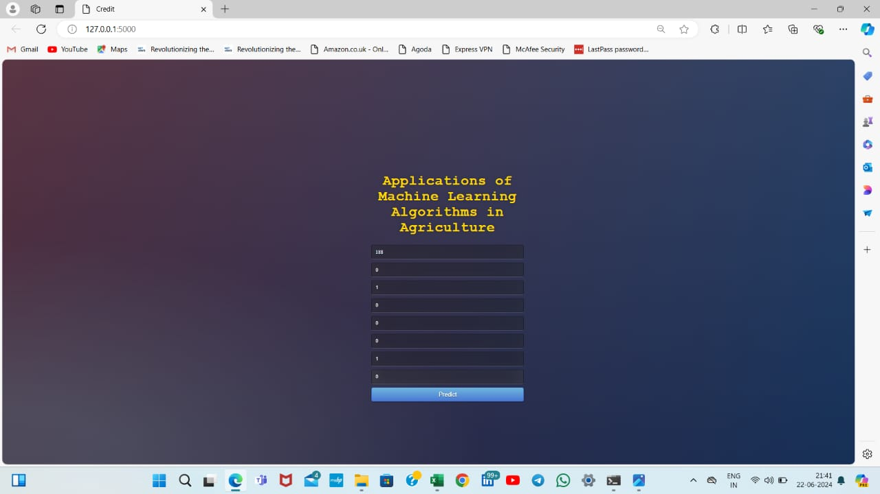
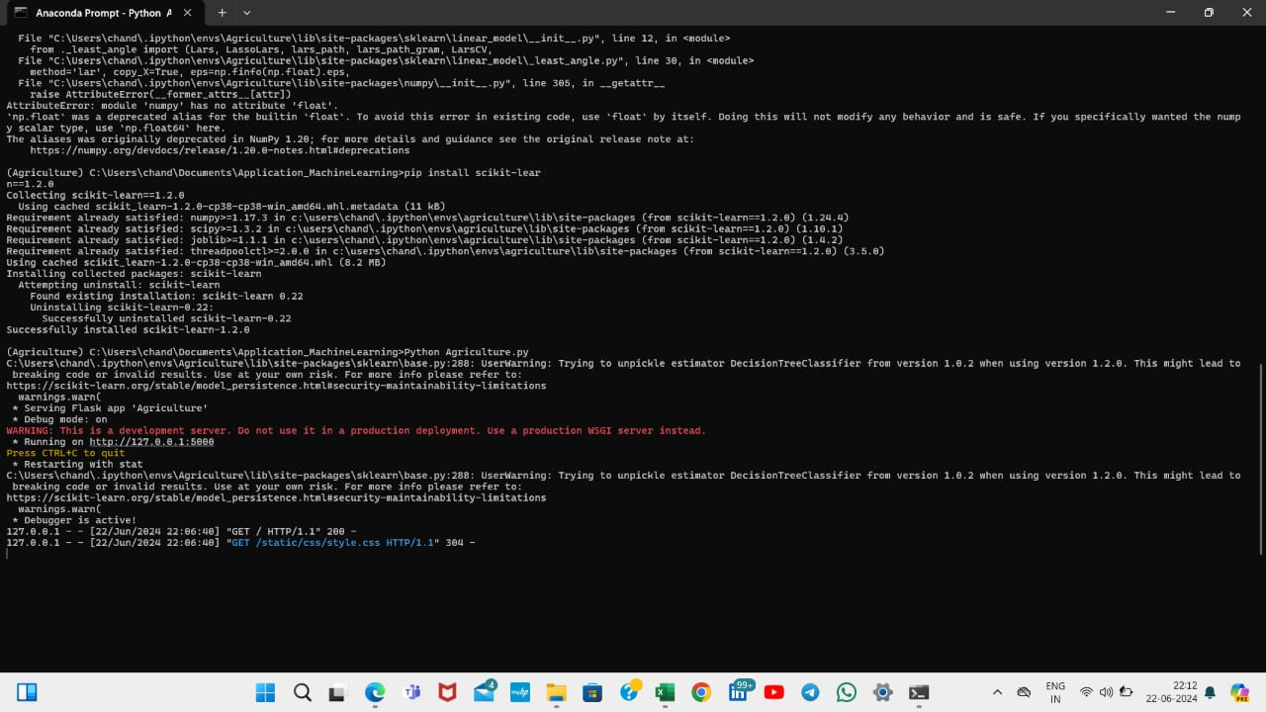
Screen shots

Slide 20
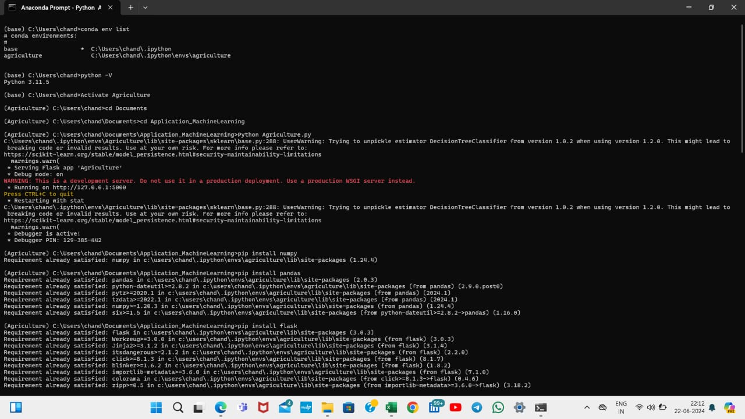
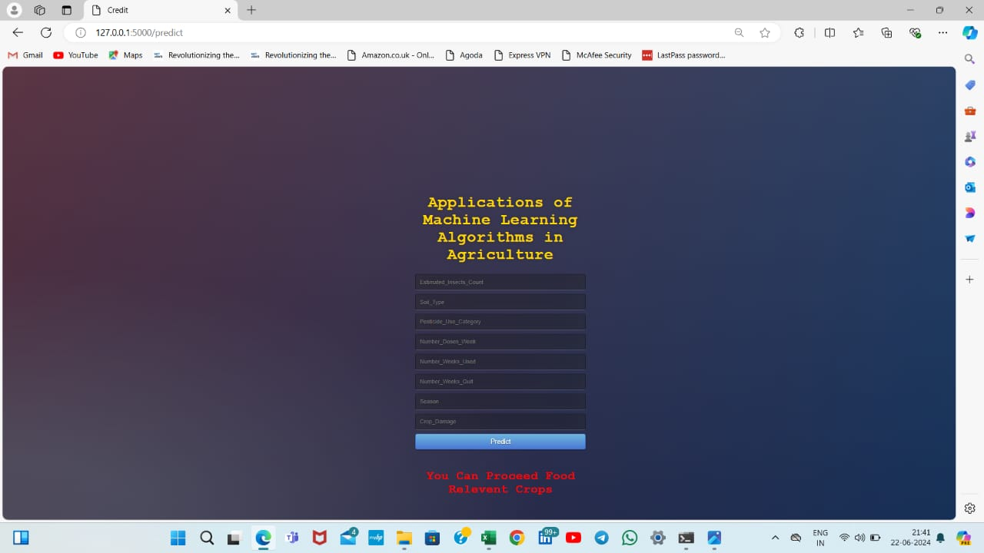

Slide 21
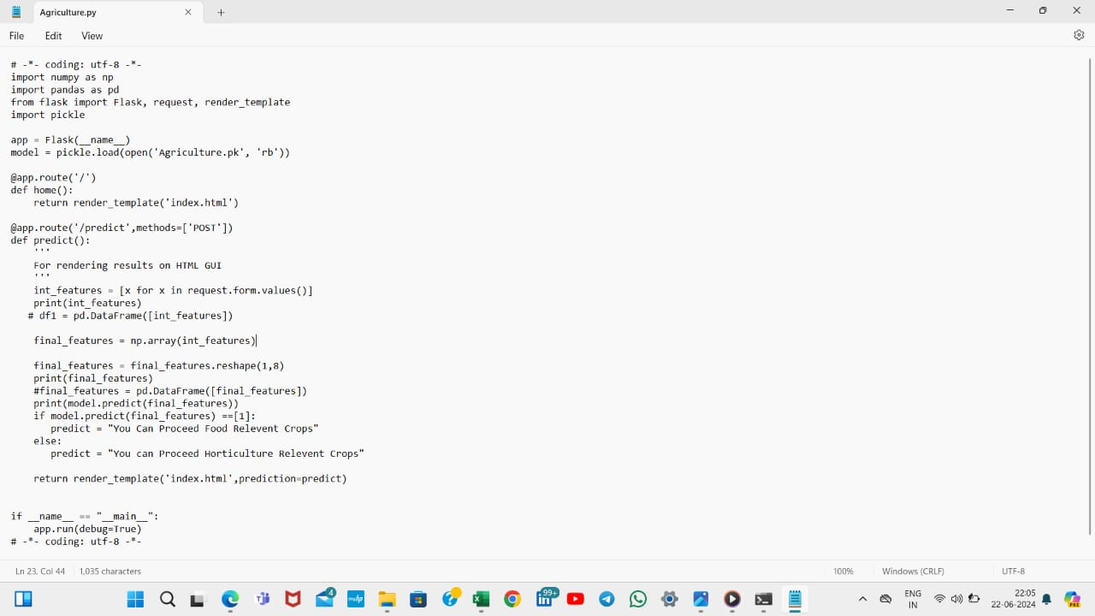
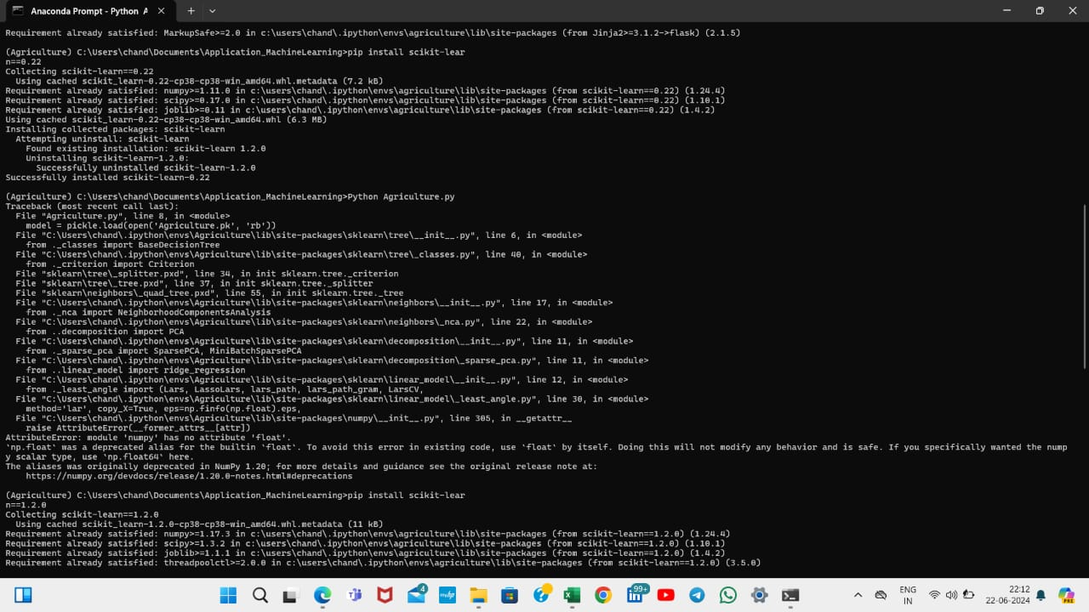

Slide 22
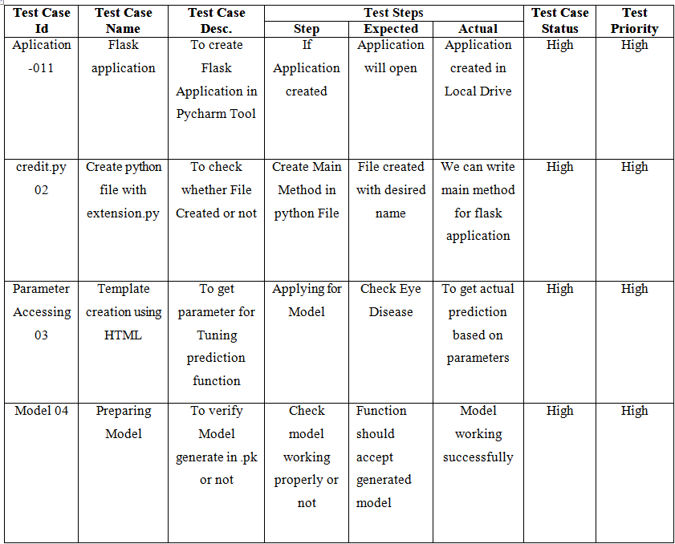
Test Cases

Slide 23
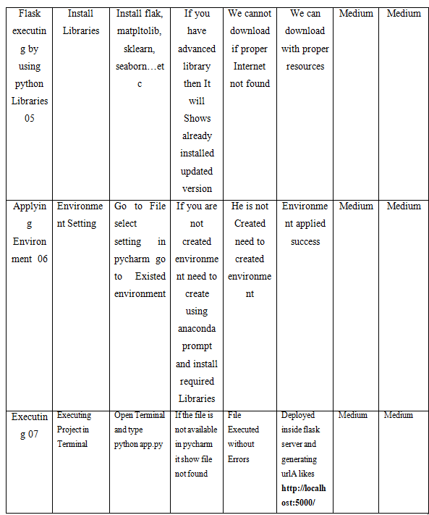

Slide 24
Conclusion
Decision-making tool has been developed for selecting suitable agricultural crop to be cultivated in the given experimental land. Twenty-six input variables are selected and grouped into six main variables such as soil, water, season, input, support and infrastructure. The evaluation scores of alternatives in the form of main variable sequences are obtained by dominance-based rough set approach and simple additive method. Johnson’s reduct classifier algorithm is used in the developed tool to generate classification rules for three agricultural crops such as paddy, groundnut and sugarcane. The validation results showed that the developed tool has sufficient predictive power to help the farmers to select suitable crop for agriculture development. Although illustrations are based on the three agricultural crops, namely paddy, groundnut and sugarcane, the developed decision-making tool can act as a multi-class classification tool to select any agricultural crop for cultivation. The limitations of this tool are as follows: Johnson’s classifier produces satisfactory results for smaller training datasets. Discernibility based attribute reduction system has input number restrictions in the dataset.

Slide 25
References
[1] Agarwal, Apoorv, Fadi Biadsy, and Kathleen R. Mckeown."Contextual phrase-level polarity analysis using lexical affect scoring and syntactic n-grams." Proceedings of the 12th Conference of the European Chapter of the Association for
Computational Linguistics. Association for Computational Linguistics, 2009.
[2] Barbosa, Luciano, and Junlan Feng. "Robust sentiment detection on twitter from biased and noisy data." Proceedings of the 23rd international conference on computational linguistics: posters. Association for Computational Linguistics, 2010.
[3] Bermingham, Adam, and Alan F. Smeaton. "Classifying sentiment in microblogs: is brevity an advantage?." Proceedings of the 19th ACM international conference on Information and knowledge management. ACM, 2010.
[4] Gamon, Michael. "Sentiment classification on customer feedback data: noisy data, large feature vectors, and the role of linguistic analysis." Proceedings of the 20th international conference on Computational Linguistics. Association for Computational Linguistics, 2004.

